Slide 1


PHP Development Course
MEC Academy

Slide 2
Agenda
Introduction
What is Backend Development
Iintroduction to PHP
Tools and Technologies
Variables
Datatypes
Constant
Operations
Selection statements (if, switch)
Implementation
Dependencies
&
Issues / Risks
Schedule (High Level)
Completed Activities
Timeline
Action
Items
Change Requests

Slide 3
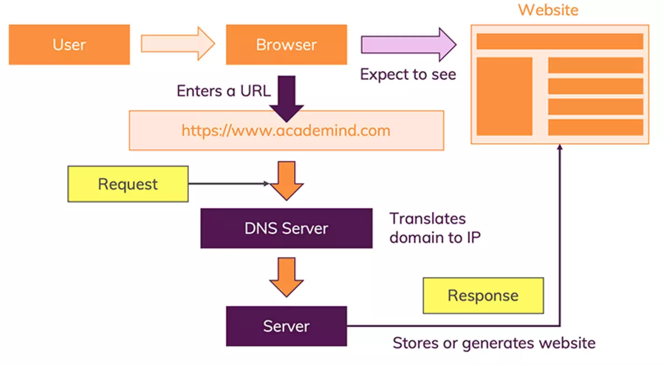
How The Web Works

Slide 4

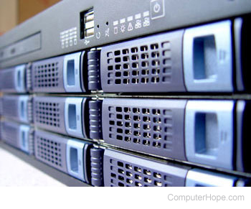
Server
A server is a software or hardware device that accepts and responds to requests made over a network. The device that makes the request, and receives a response from the server, is called a client. On the Internet, the term "server" commonly refers to the computer system that receives requests for a web files and sends those files to the client.

Slide 5
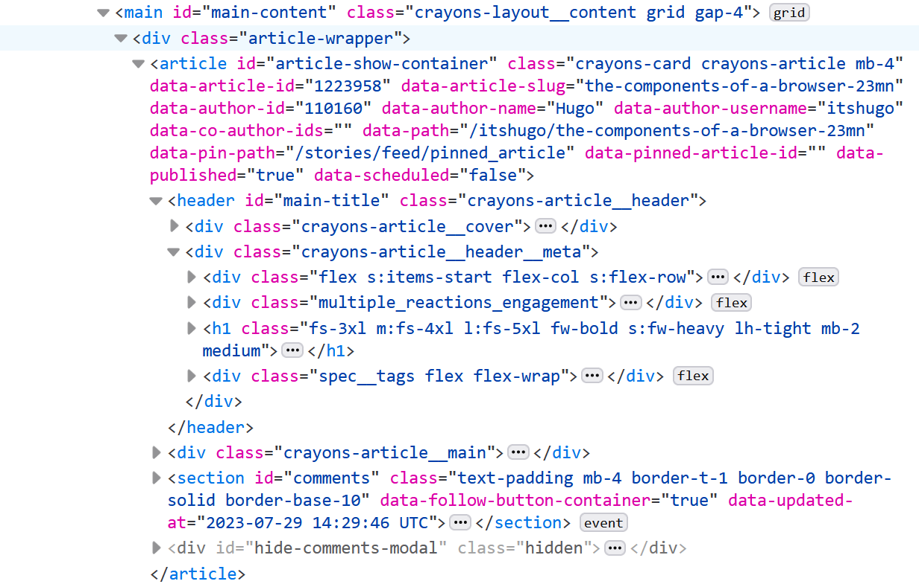
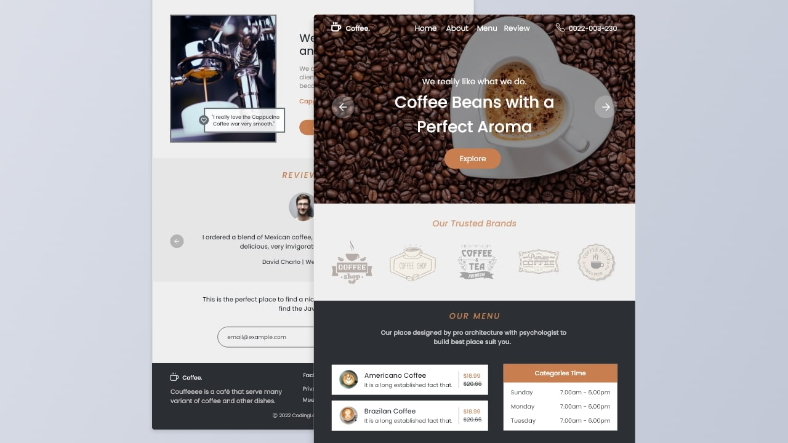

Response

Slide 6
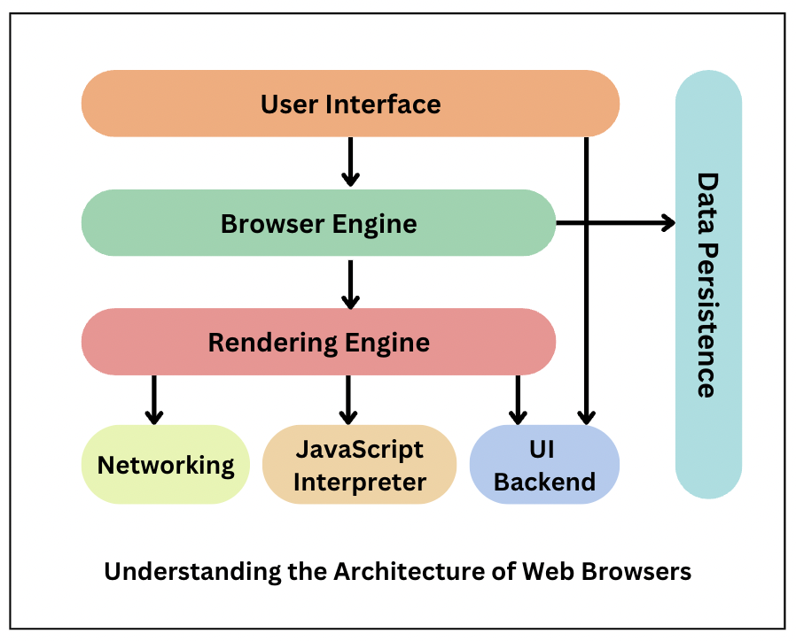
Browser Component
Browser
A Web browser is a client program that uses HTTP (Hypertext Transfer Protocol) to make requests of Web servers throughout the Internet on behalf of the browser user. Most browsers support e-mail and the File Transfer Protocol (FTP), but a Web browser is not required for those Internet protocols and more specialized client programs are more popular

Slide 7
OSI Model

Slide 8
Counting System

Slide 9
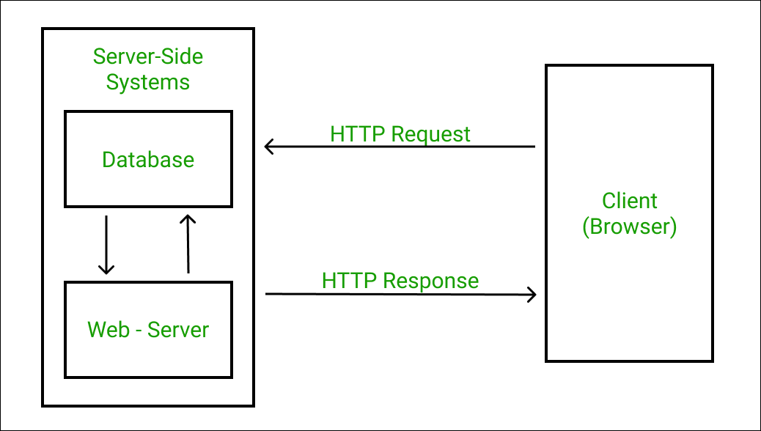
What is Backend Development
Backend Development is the term for the behind-the-scenes activities that happen when you do anything on a website or web application. Backend Development is mostly referred to as the server-side of an application and everything that communicates between the database and the frontend (browser). You can also say that Backend Development the server-side of development that focuses primarily on how the site works.

Slide 10
Backend Development: Tools and Technologies
Server ( Apache ) : A computer that listens for incoming requests from the clients.
Communication Protocol ( HTTP ) : It comprises of the formal description of rules and formats of a digital messages.
Databases ( MYSQL ) : provide an interface to save data in a persistent way to memory.
Programming Language ( PHP )

Slide 11
Intro To PHP
PHP is a leading server-side scripting technology that was introduced by Rasmus Lerdorf in 1994.
This open-source backend technology is commonly used for websites. Around 79.1% of websites on the internet use PHP as server-side technology, according to a recent survey of W3Techs.
This general-purpose scripting language is easy to use and emend information in the databases.
The availability of several modern frameworks, massive community,
robust codebase, and easy deployment also adds tremendous value to this technology.

Slide 12
PHP Features
Open Source & Platform Independent
Security Against Target Attacks
Simplifies Programming
Cost-Effective

Slide 13
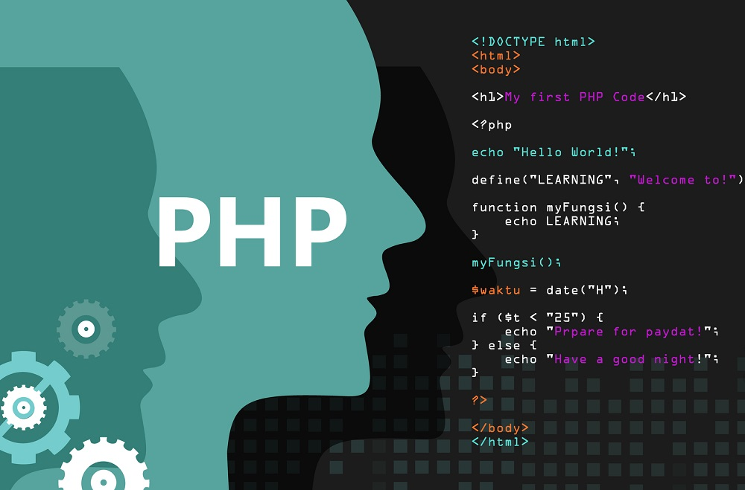
What does Syntax mean?
Syntax is the set of rules that define what the various combinations of symbols mean.
This tells the computer how to read the code.

Slide 14
“Any fool can write code that a computer can understand. Good programmers write code that humans can understand ”
—Martin Fowler

Slide 15
Variables
Variables are containers for storing data values.
Variable is a name of memory location.
Variable is an identifier which holds data or another one. variable is an identifier whose value can be changed at the execution time of program.

Slide 16
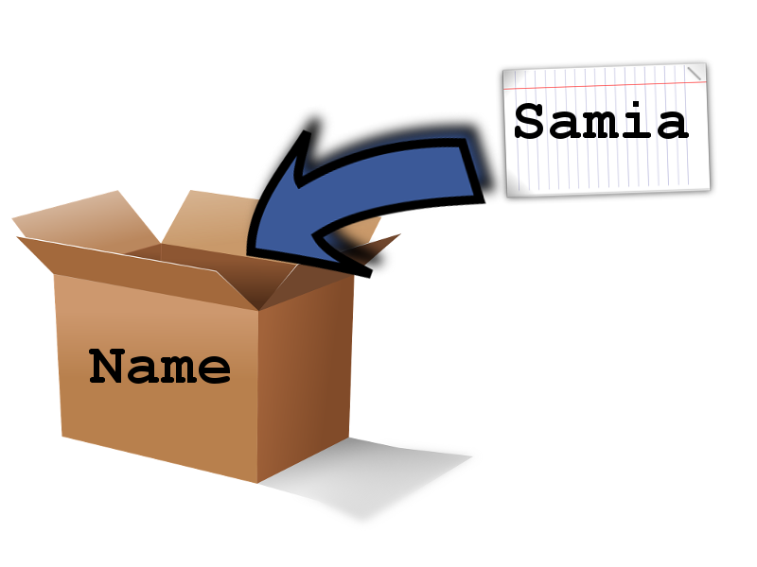
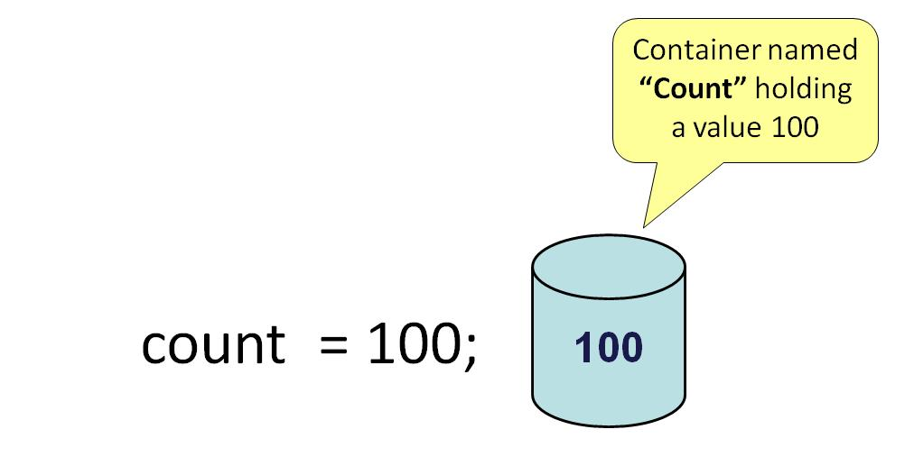
Variables

Slide 17
Variables
In PHP, a variable starts with the $ sign, followed by the name of the variable
Rules:
A variable starts with the $ sign, followed by the name of the variable
A variable name must start with a letter or the underscore character
A variable name cannot start with a number
A variable name can only contain alpha-numeric characters and underscores (A-z, 0-9, and _ )
Variable names are case-sensitive ($age and $AGE are two different variables)

Slide 18
Data Types
String
Integer
Float
Boolean
Array
Object
Null

Slide 19
Constant
Constants are like variables except that once they are defined, they cannot be changed or undefined.
To create a constant, use the define() function
Syntax:
define(name, value, case-insensitive)
<?php
define(“NAME", “Ahmed", true);
echo NAME; //Ahmed
?>
Keep In my mind that Constants are automatically global and can be used across the entire script.!!!!!!!!

Slide 20
Operators
Operators are used to perform operations on variables and values.
Arithmetic
Comparison
Logical
Assignment

Slide 21
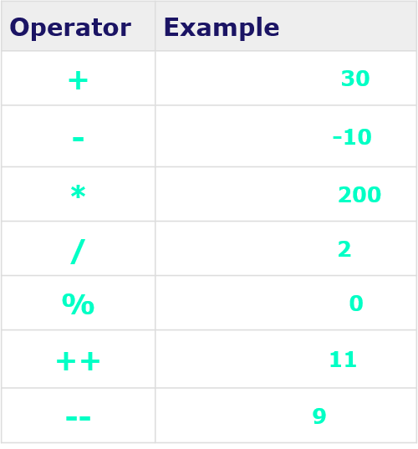
Arithmetic
When A holds 10 and variable B holds 20
Arithmetic

Slide 22
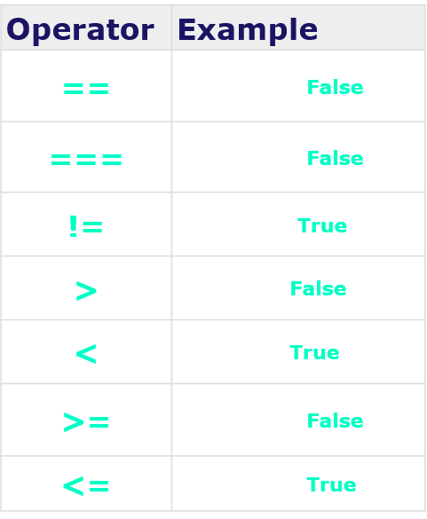
Comparison
When A holds 10 and variable B holds 20
Arithmetic

Slide 23
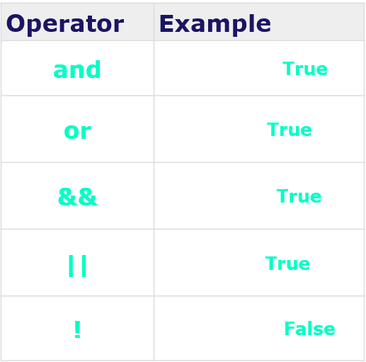
Logical
When A holds 10 and variable B holds 20
Arithmetic

Slide 24
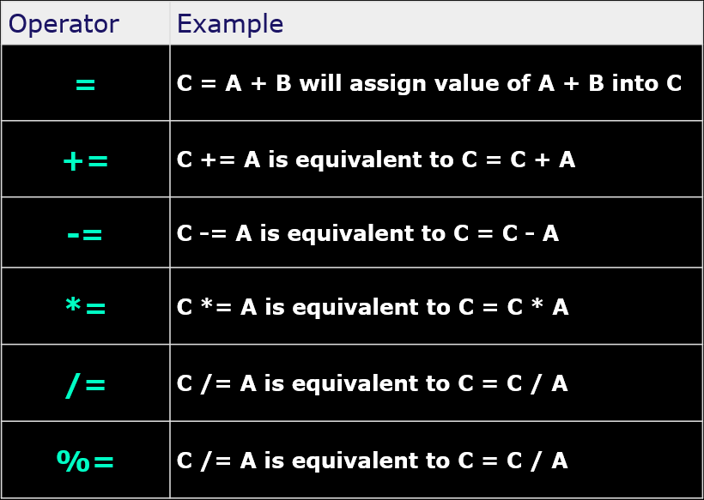
Assignment
When A holds 10 and variable B holds 20
Arithmetic

Slide 25
Selection Statements
Arithmetic

Slide 26


